Slide 1


Mantid for Data Analysis
Nick Draper (Tessella)

Slide 2
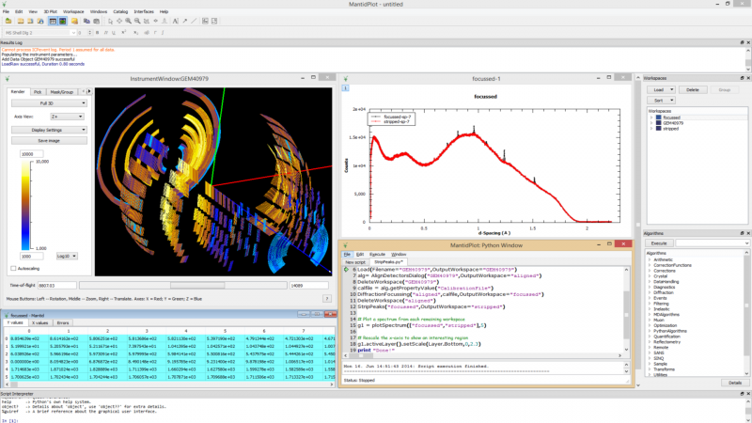
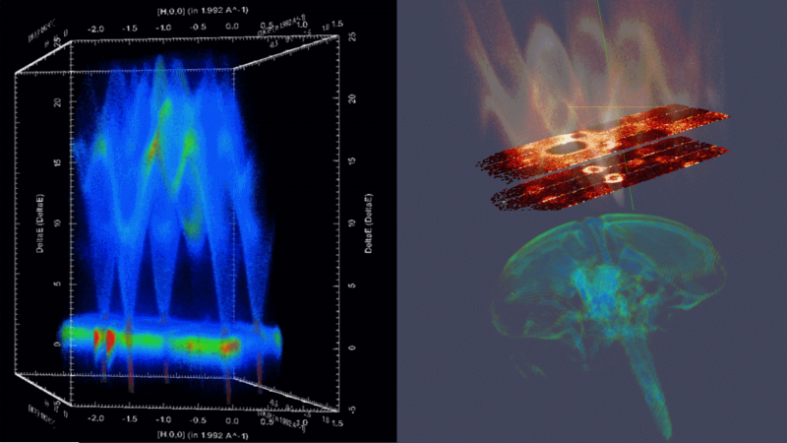
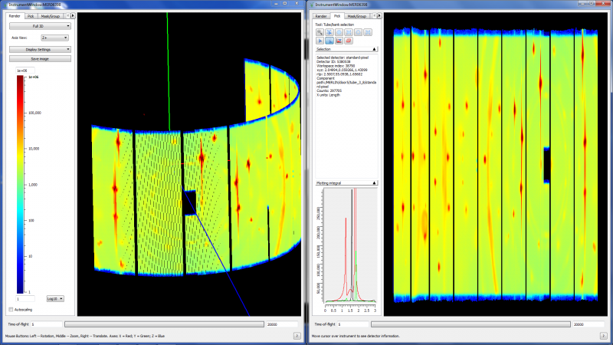
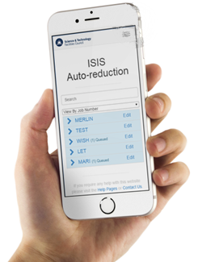
The Mantid Project

Slide 3
Project Goals
Goals
Consolidate the data reduction/analysis software for neutron scattering experiments
Without restricting the needs of the instrument scientists
Key requirements
Cross-platform
Easily extensible
Freely redistributable
Open source

Slide 4
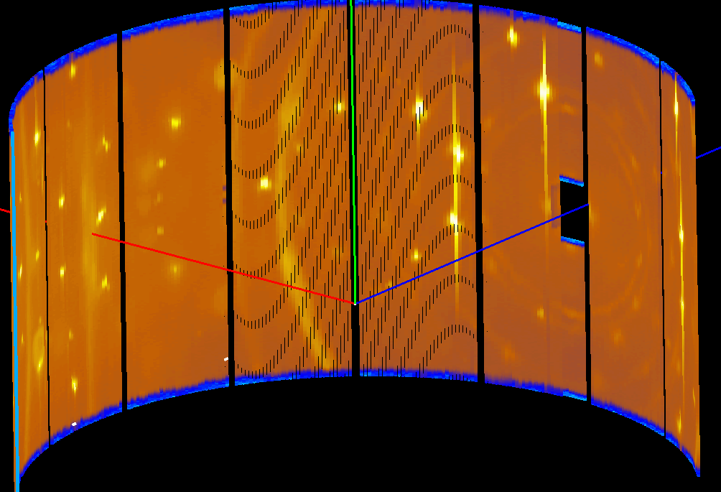
Scientific Data Flow
Raw Data
Time & Detector Coords
Useful for Diagnostics & Fault finding
Full of measurement artefacts

Slide 5
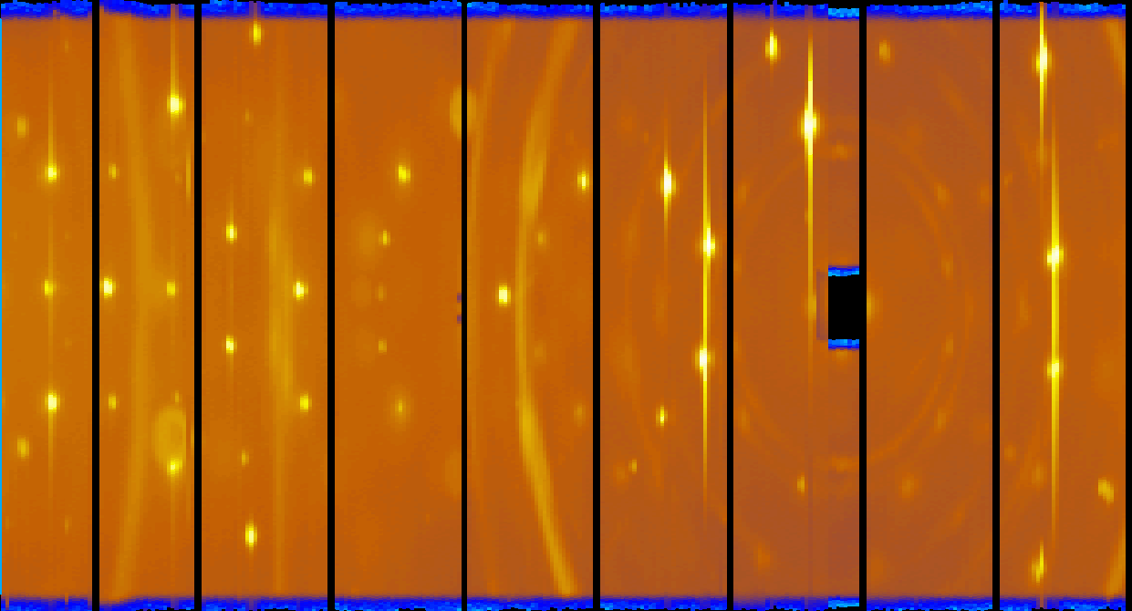
Raw Data
Merlin
256 x 272 = 70K Pixels
x 500 = 35M Pixels
x 5 incident energies
= 175M Pixels
256 Detectors
500 Time Channels
272 Tubes

Slide 6
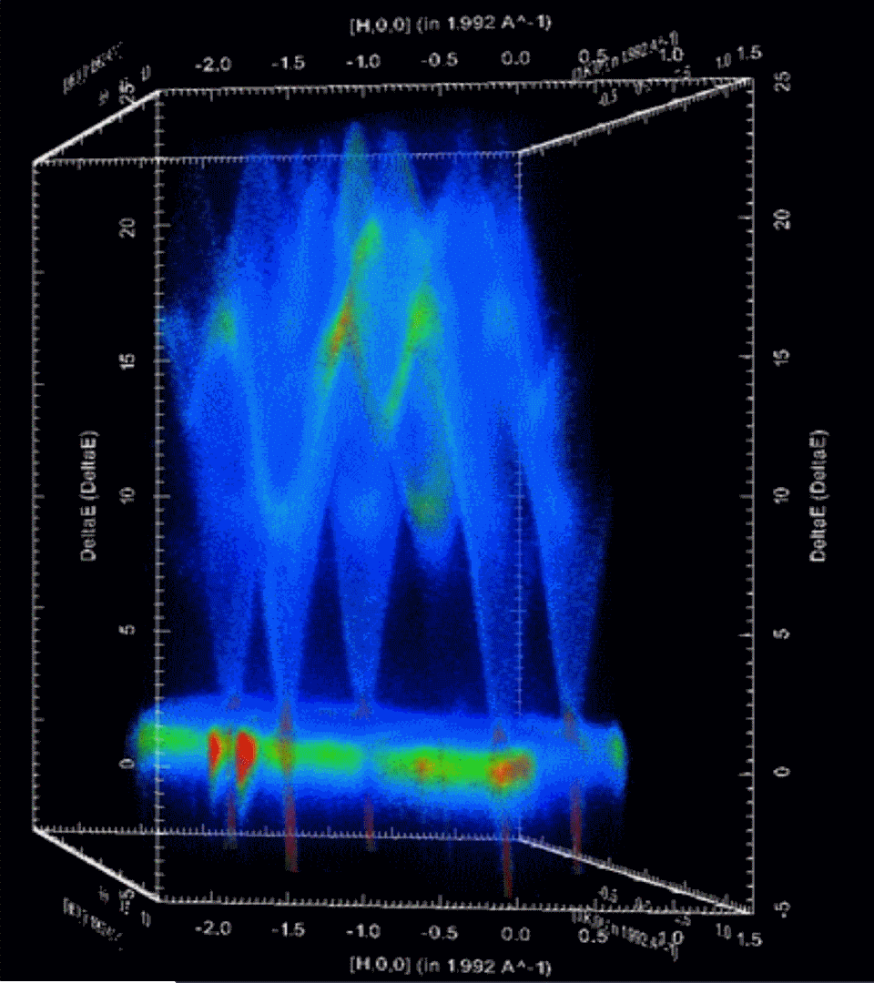
Scientific Data Flow
Raw Data
Time & Detector Coords
Reduced Data
Measurement artefacts corrected
Scientific Units
Useful for Diagnostics & Fault finding
Full of measurement artefacts
Size: compressed or expanded

Slide 7
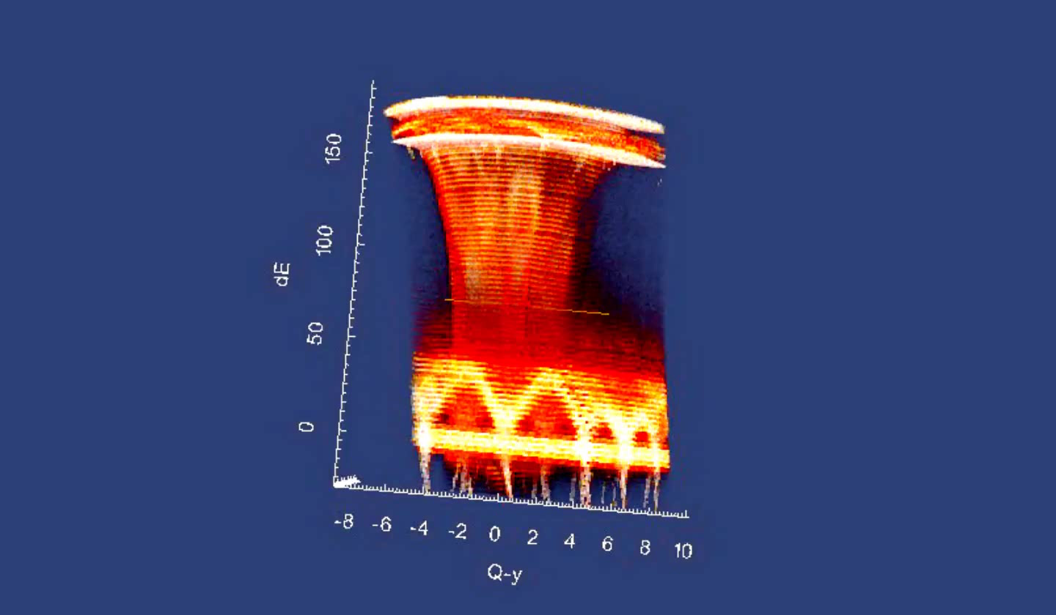
Multi Dimensional Visualization

Slide 8

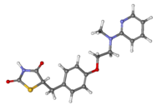
Scientific Data Flow
Raw Data
Time & Detector Coords
Reduced Data
Measurement artefacts corrected
Scientific Units
Data Analysis
Comparison with physical models
Extraction of understanding
Impact
Useful for Diagnostics & Fault finding
Full of measurement artefacts
Size: compressed or expanded
New materials
Process changes
Commercialization
Scientific Publication

Slide 9
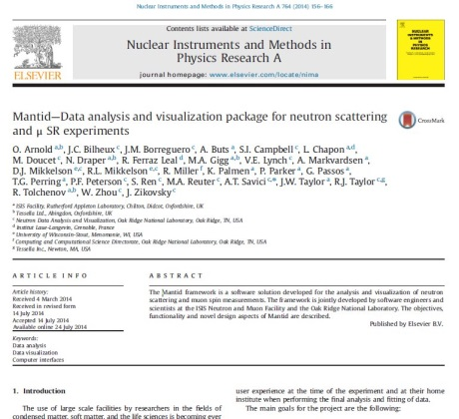
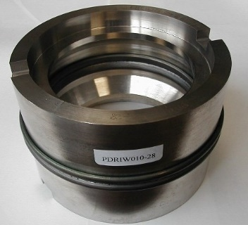
Scientific Data Flow
Raw Data
Time & Detector Coords
Reduced Data
Measurement artefacts corrected
Scientific Units
Data Analysis
Comparison with physical models
Extraction of understanding
Impact
Useful for Diagnostics & Fault finding
Full of measurement artefacts
Size: compressed or expanded
Commercialization
Scientific Publication
Process changes
New materials

Slide 10

Scientific Data Flow
Raw Data
Time & Detector Coords
Reduced Data
Measurement artefacts corrected
Scientific Units
Data Analysis
Comparison with physical models
Extraction of understanding
Impact
Useful for Diagnostics & Fault finding
Full of measurement artefacts
Size: compressed or expanded
Commercialization
Scientific Publication
Process changes
New materials
Visualization
Algorithms
Model Fitting & Optimisation
Live Data

Slide 11
Some Users
Most Users
Flexible user interface
Python Scripting
Technique specific interfaces
Point and click interface
Training & Examples
Super Users
Plug ins
Python Algorithms
Custom User Interfaces
Detailed help
Data History
Powerful visualisations
Simple Graphing
Matching the users experience

Slide 12
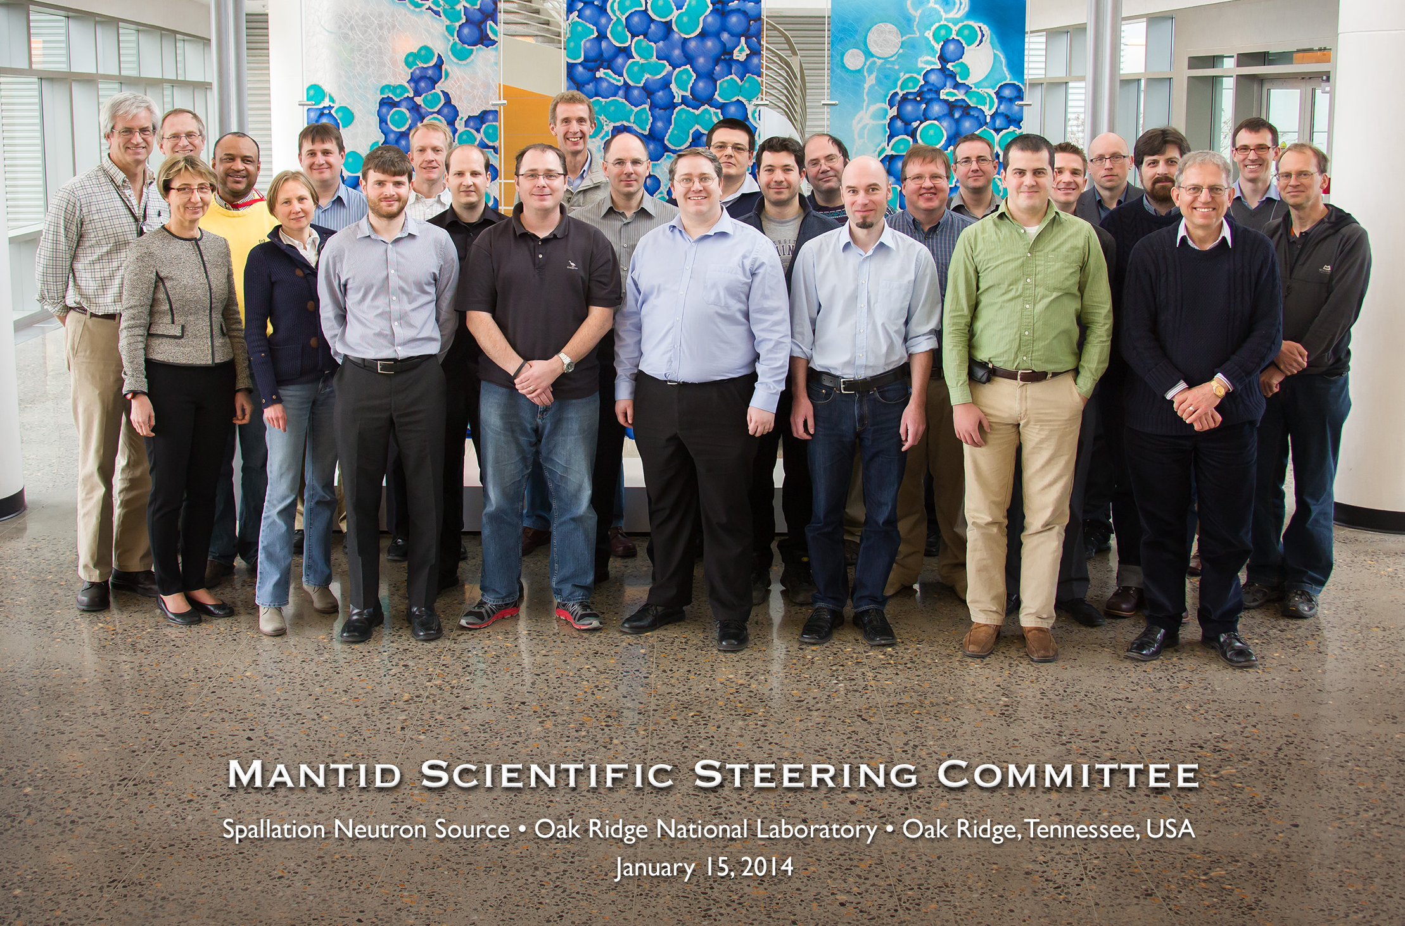
Professional development
Distributed Development Team
International Project Governance Board & Scientific Steering Committee
Dedicated software engineers
All with science BSc, many with PhD
Working closely with Instrument Scientists
Build and testing automation
20+ build servers
World class static code analysis
11,900 unit tests
350 automated system tests
Comprehensive documentation
868 automated tests on included scripts
Both online and installed with Mantid

Slide 13
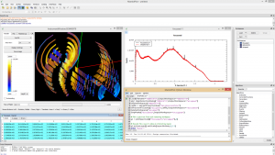
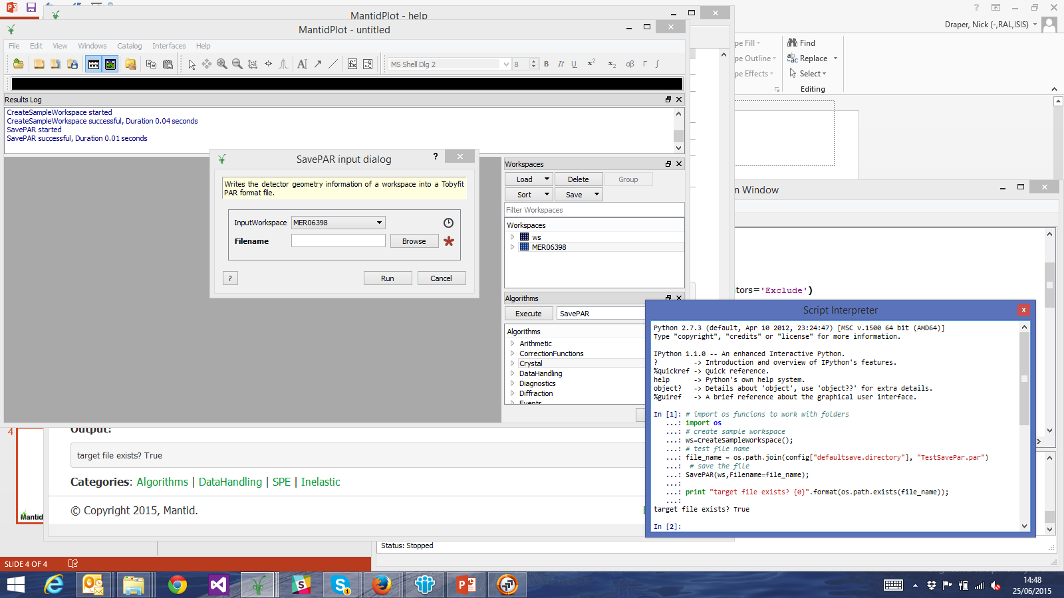
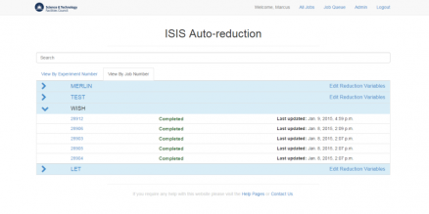
Architecture
Algorithms
Corrections
Input / Output
Support Services
Live Data
Model Fitting
Workspaces
Data
Sample Info
Instrument Geometry
Transforms
Diagnostics
Filtering
Simulation
Technique Specific
API

Slide 14
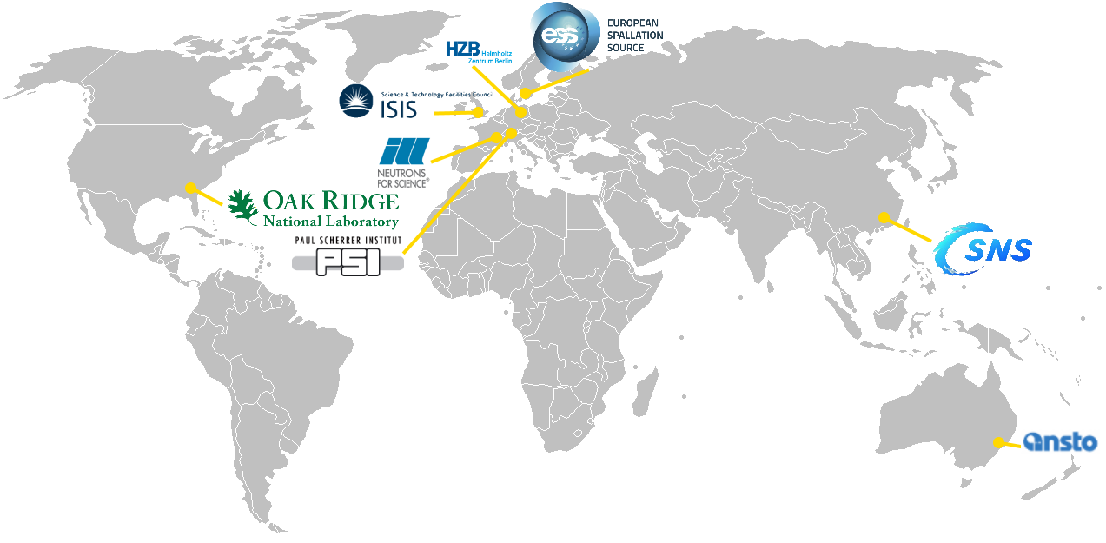
International Collaboration

Slide 15
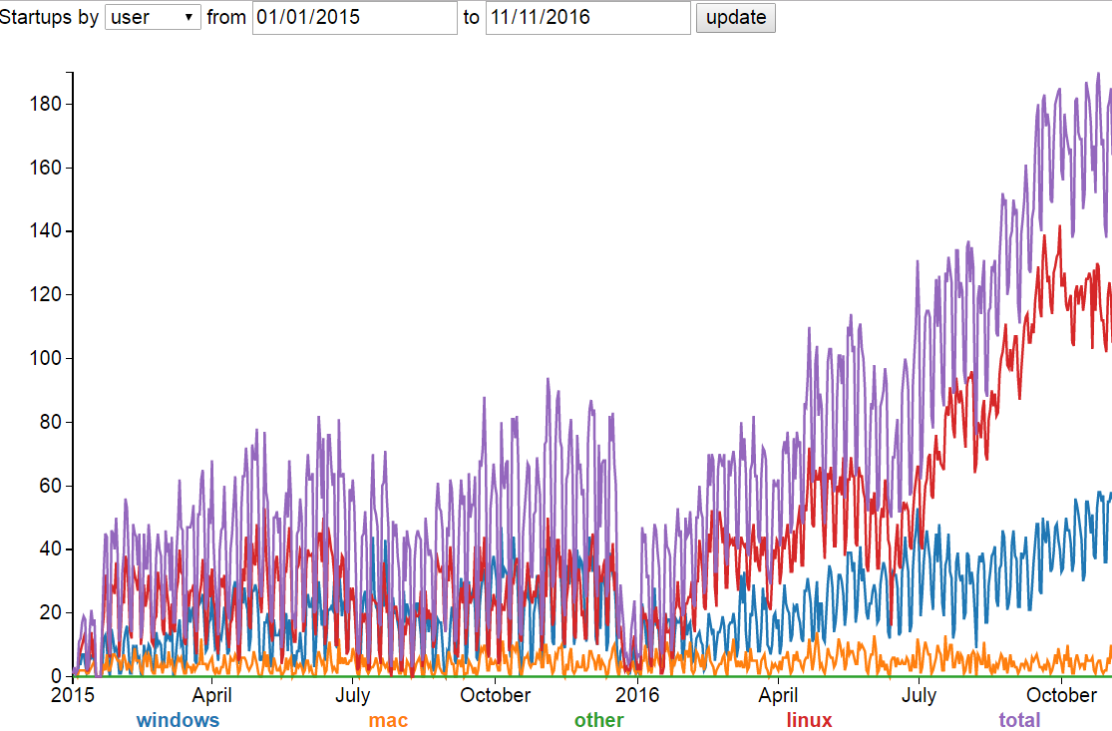
Usage
http://reports.mantidpoject.org

Slide 16
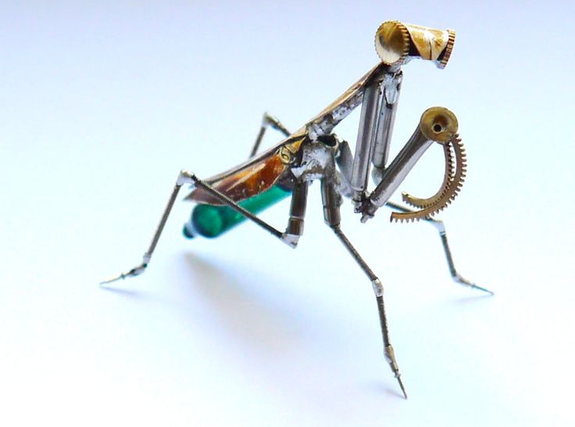
Analysis In Mantid

Slide 17
Reduction vs Analysis
Mantid’s key scope is Data reduction
Some techniques have accepted tools for analysis
GSAS for diffraction
SASView for SANS
Then Mantid interfaces with the accepted tools
Others don’t
Here Mantid goes further itself

Slide 18
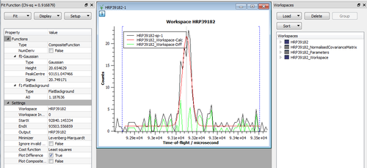
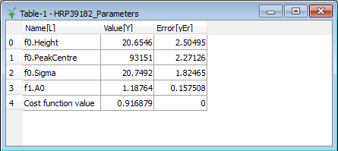
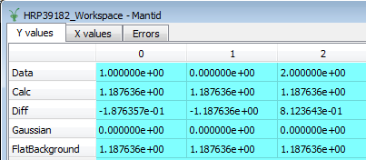
Fitting
Simple and comprehensive fitting
Visual or scriptable
Build simple or complex models
Constraints
Choice of Minimizers
Single or Multiple spectra
Extensible
Math
Python
C++
1D, 2D -> nD model fitting

Slide 19
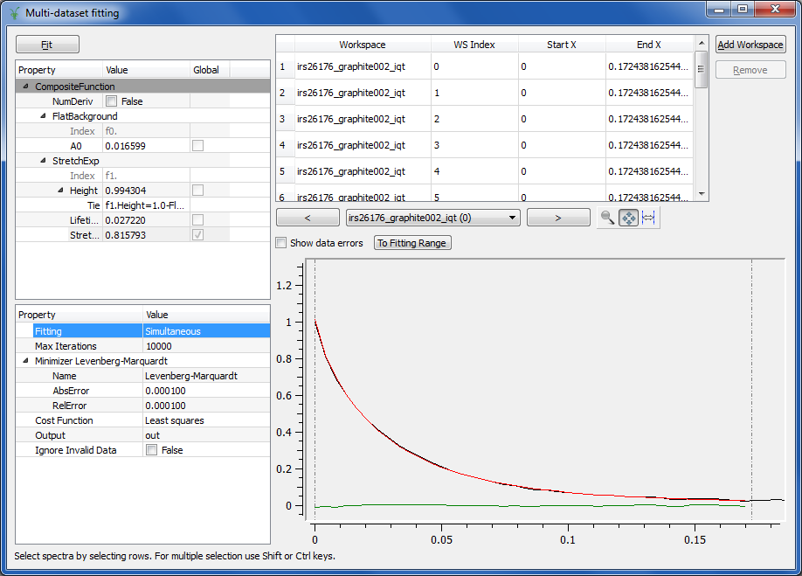
Multi dataset fitting
Simultaneous model fitting to multiple datasets
Same model building and constraints
Local or Global parameters

Slide 20
Fit functions as PLUGINS
Mantid’s fitting functions can be added to by user-defined plugins
Written in Python
Optimization framework oblivious to plugin nature
Free to use any minimizer, cost function available in Mantid

Slide 21
Simple Example: LINEAR
Place the following in a file called ‘LinearFunction.py’ on Mantid’s python plugin path (see MantidPlot preferences)
from mantid.api import IFunction1D, FunctionFactory
class LinearFunction(IFunction1D):
def init(self):
self.declareParameter(“A", 1.0)
self.declareParameter(“B", 1.0)
def function1D(self, x):
# x is a 1D numpy array
a = self.getParameterValue(“A")
b = self.getParameterValue(“B")
# Mantid expects a 1D numpy array the same size as x
return a*x + b
# Register with Mantid
FunctionFactory.subscribe(LinearFunction)
Notes:
Fully functioning example
Derivatives calculated numerically
Only hard part really is getting the function1D definition correct

Slide 22
Adding Derivatives
Analytic derivatives can be added if desired. In most scenarios the numerical ones should be adequate
from mantid.api import IFunction1D, FunctionFactory
class LinearWithDerivative(IFunction1D):
# … snipped. Same as previous slide …
def functionDeriv1D(self, x, jacobian):
# Compute the matrix of partial derivatives
for i, x_i in enumerate(x):
jacobian.set(i, 0, 1) # paramter at index 0
jacobian.set(i, 1, x_i) # paramter at index 1
# Register with Mantid
FunctionFactory.subscribe(LinearWithDerivative)
For more information see our final training course:
www.mantidproject.org/Extending_Mantid_With_Python

Slide 23
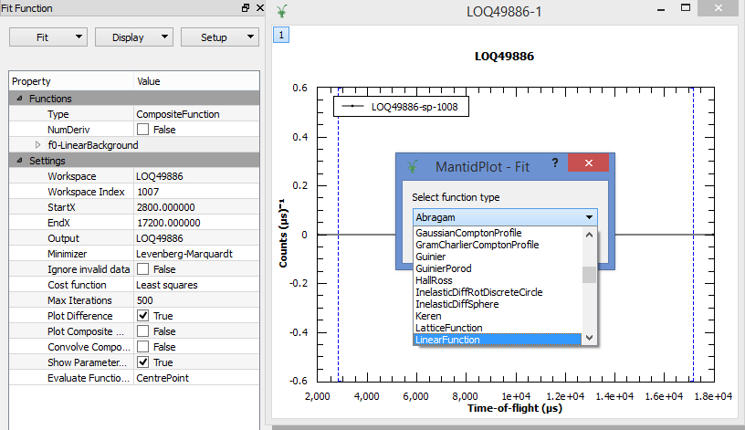
Available in Mantidplot

Slide 24
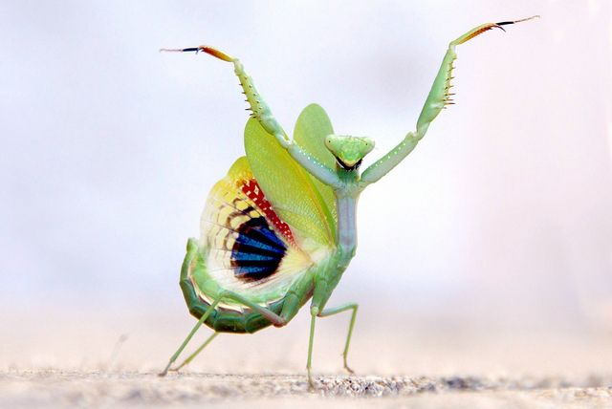
Linking mantid, mcstas and sasview

Slide 25

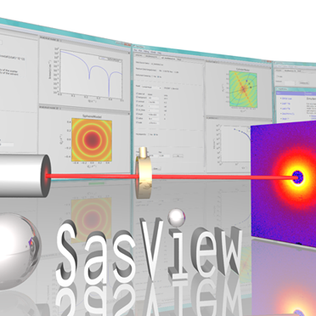

“Full-circle” virtual experiment software integration
Neutron transport
Reduction
Data analysis
Mantid
Slides from Peter Willendrup: NOBUGS|2016 / Integrating software: SASview, McStas and Mantid

Slide 26
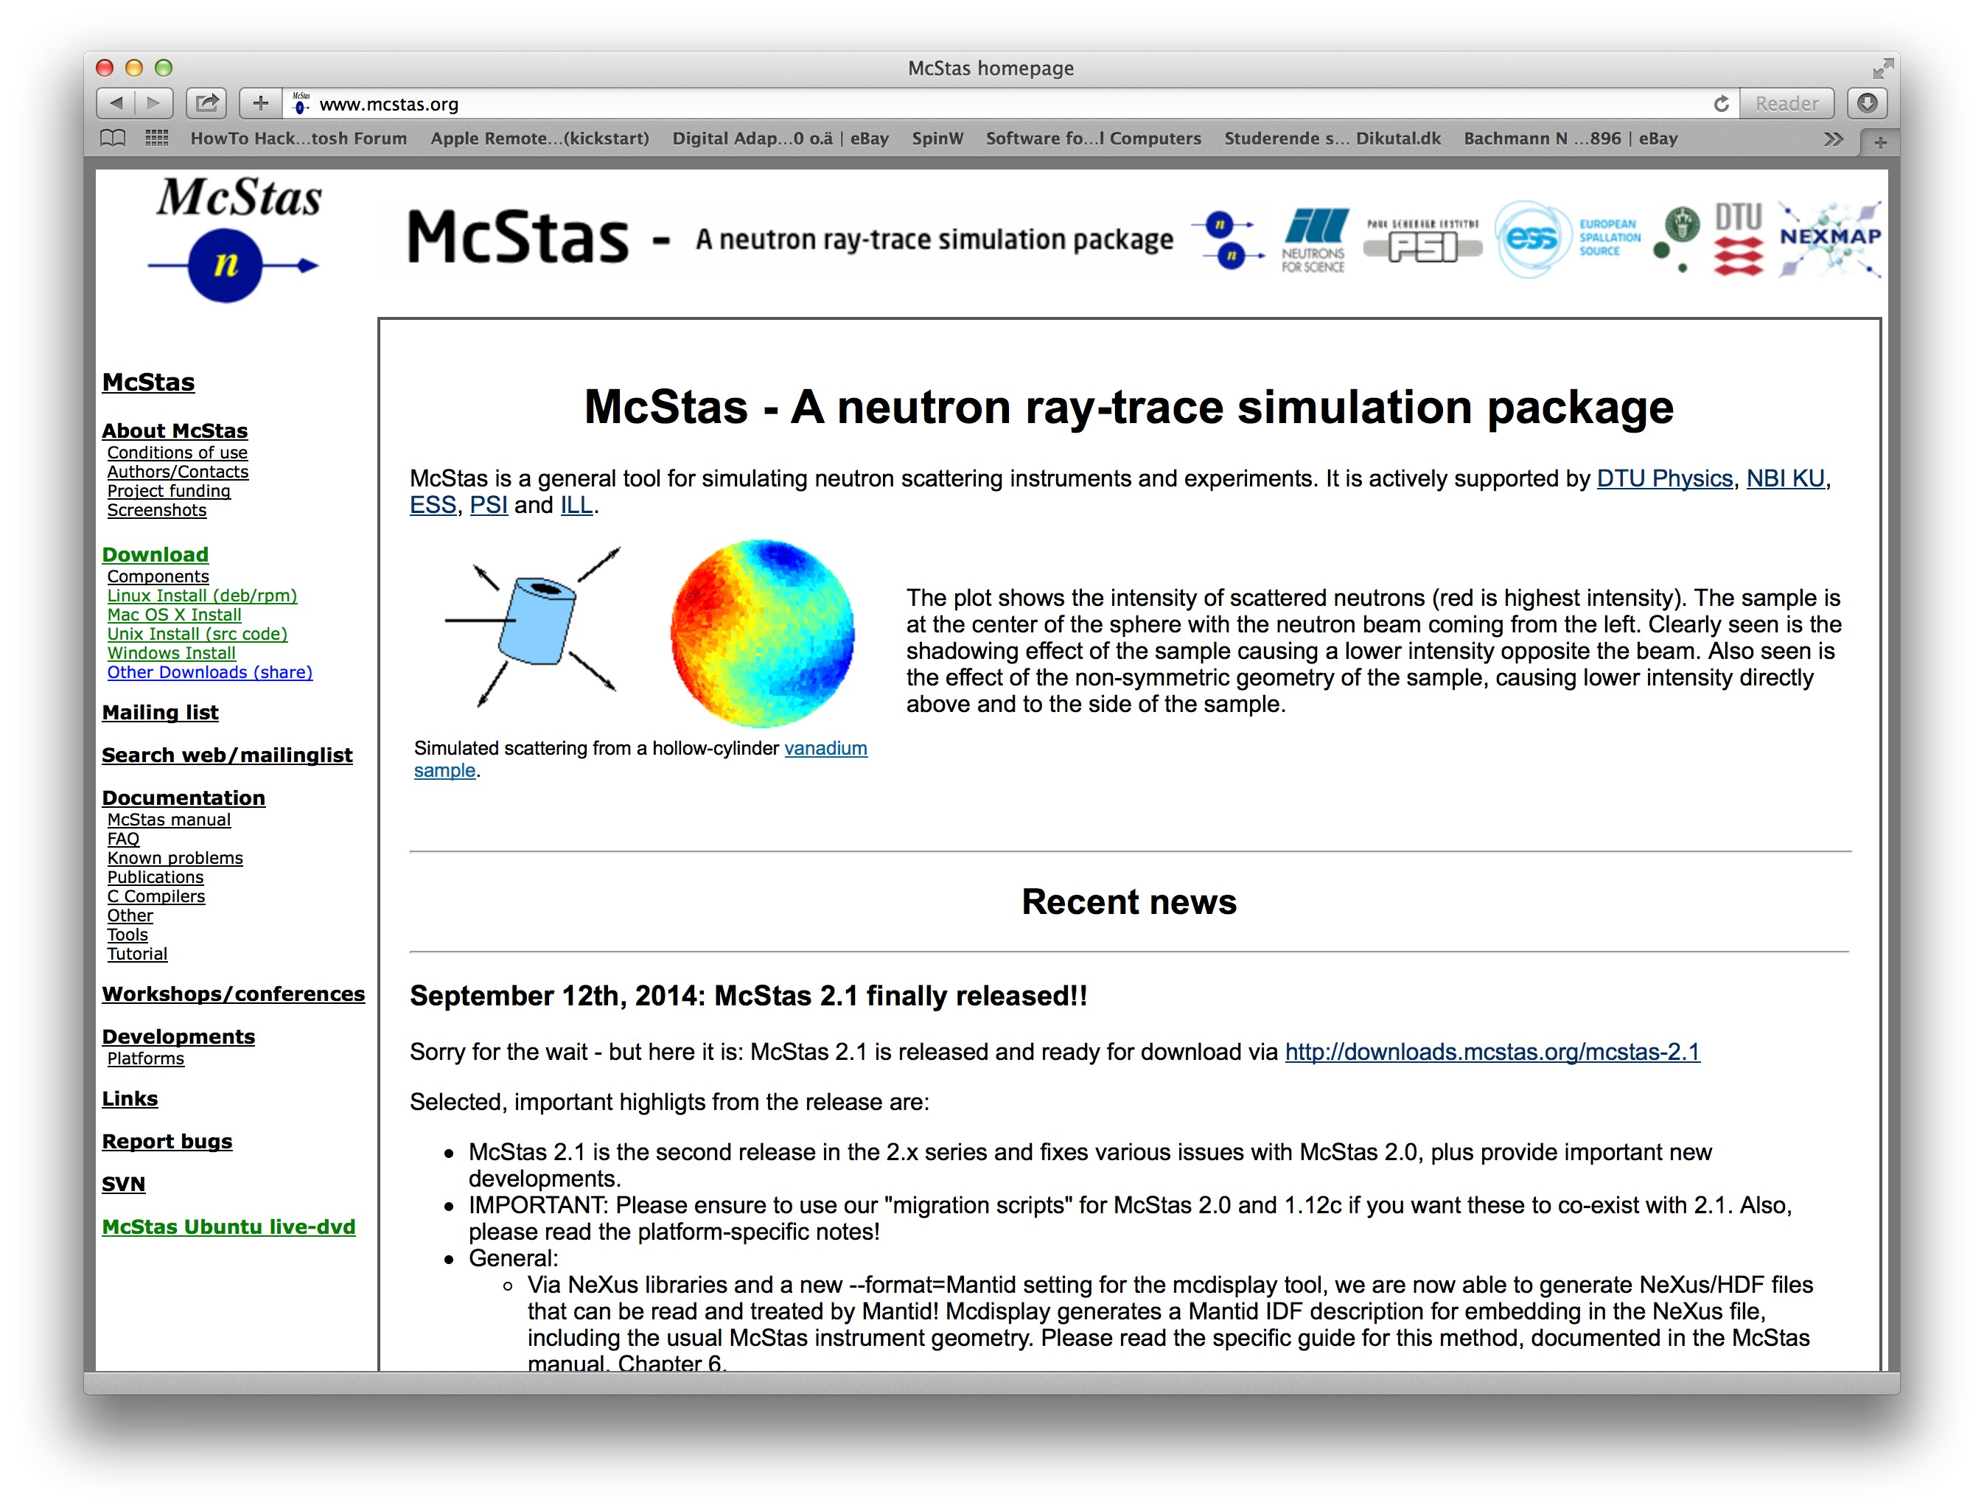
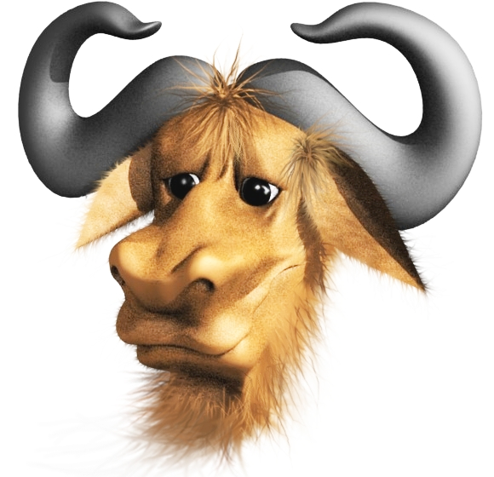
McStas Introduction
http://www.mcstas.org
Flexible, general simulation utility for neutron scattering experiments.
Original design for Monte carlo Simulation of triple axis spectrometers
Developed at DTU Physics, ILL, PSI, Uni CPH, ESS
V. 1.0 by K Nielsen & K Lefmann (1998) RISØ
Currently 2.5+1 people full time plus students
GNU GPL license
Open Source
Slides from Peter Willendrup: NOBUGS|2016 / Integrating software: SASview, McStas and Mantid

Slide 27
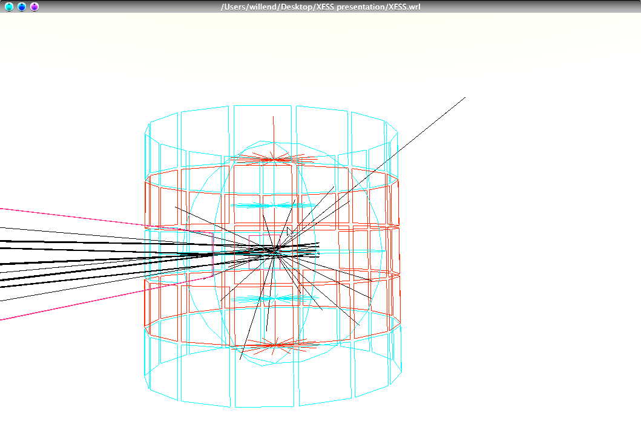
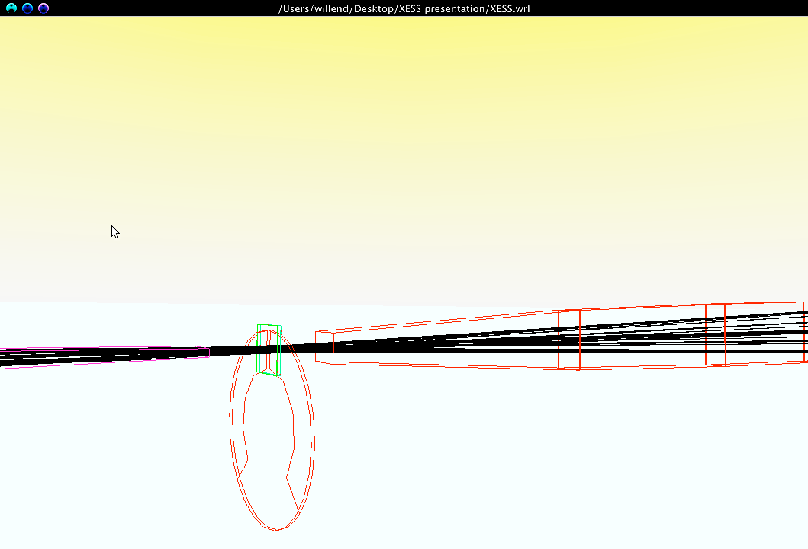
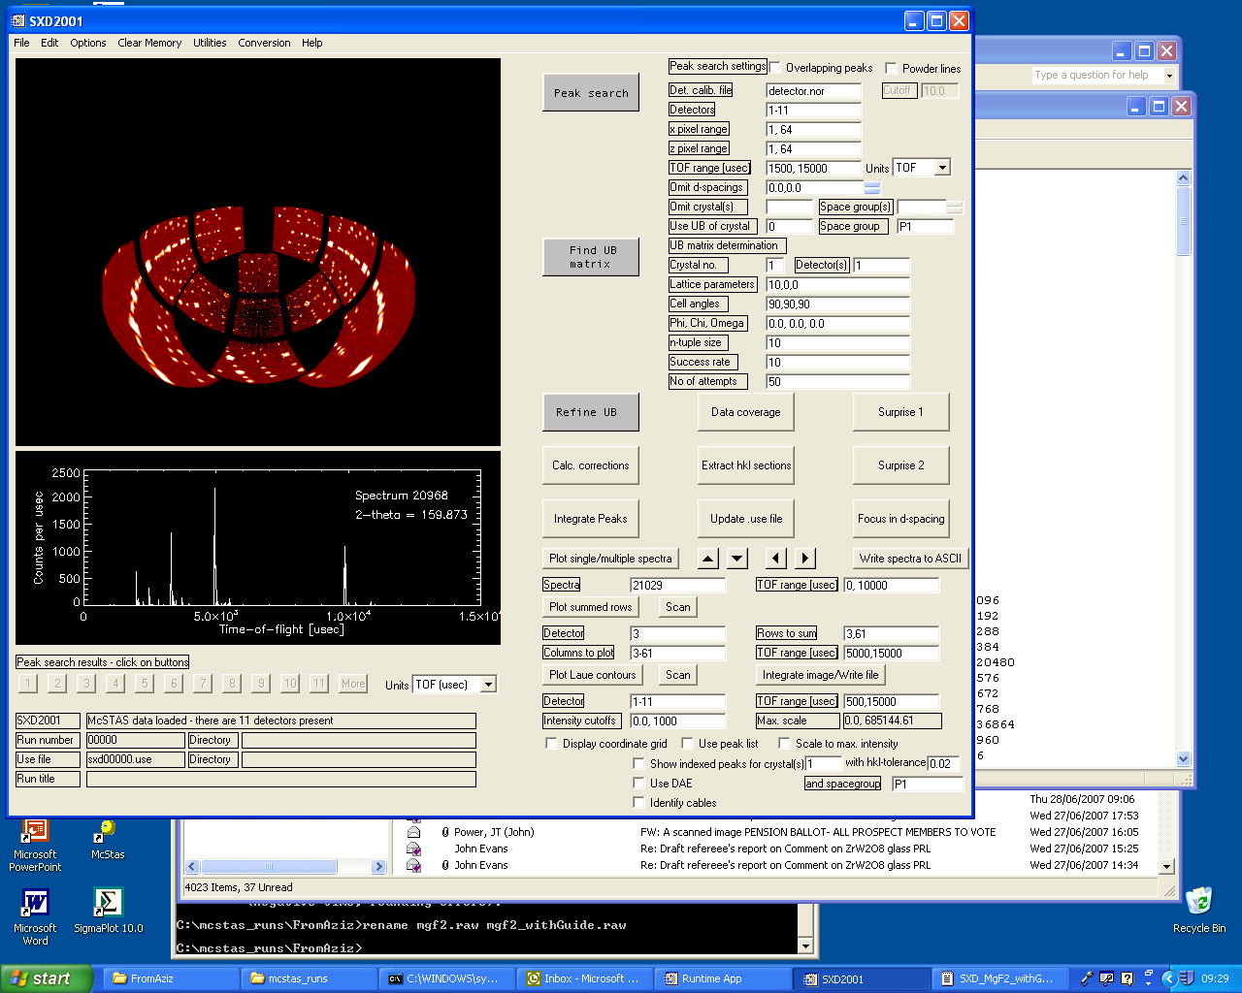
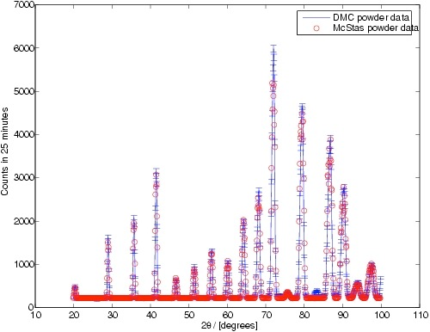
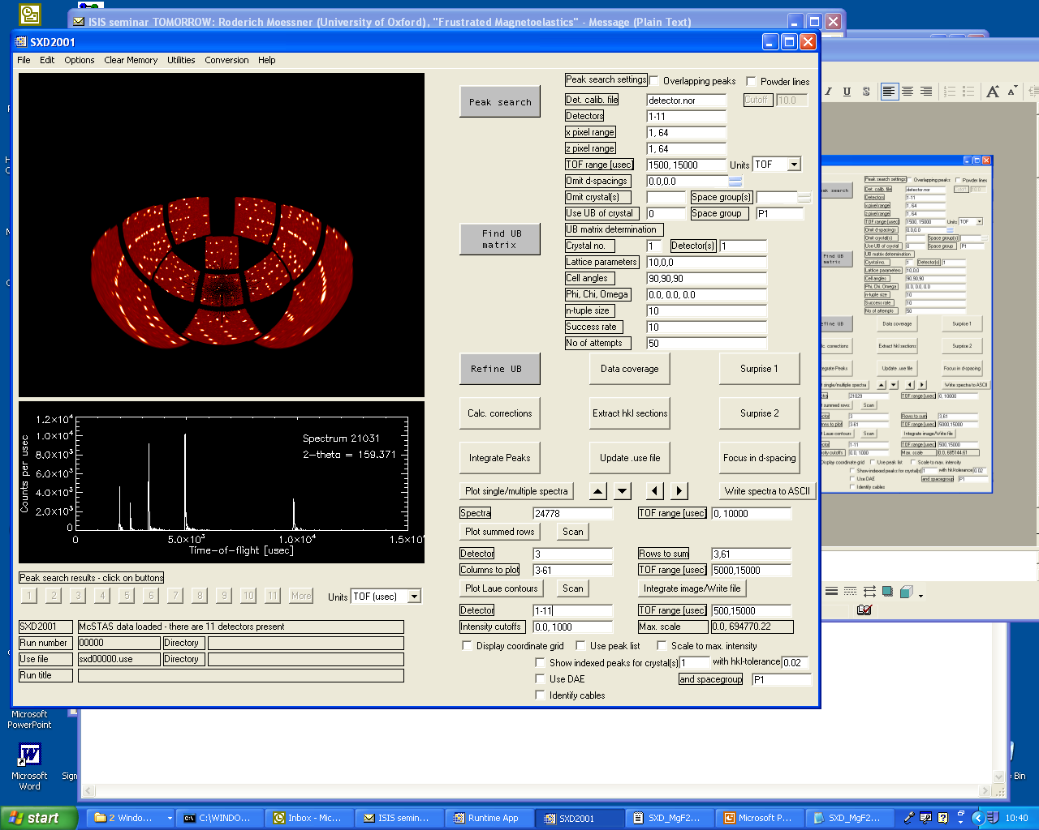
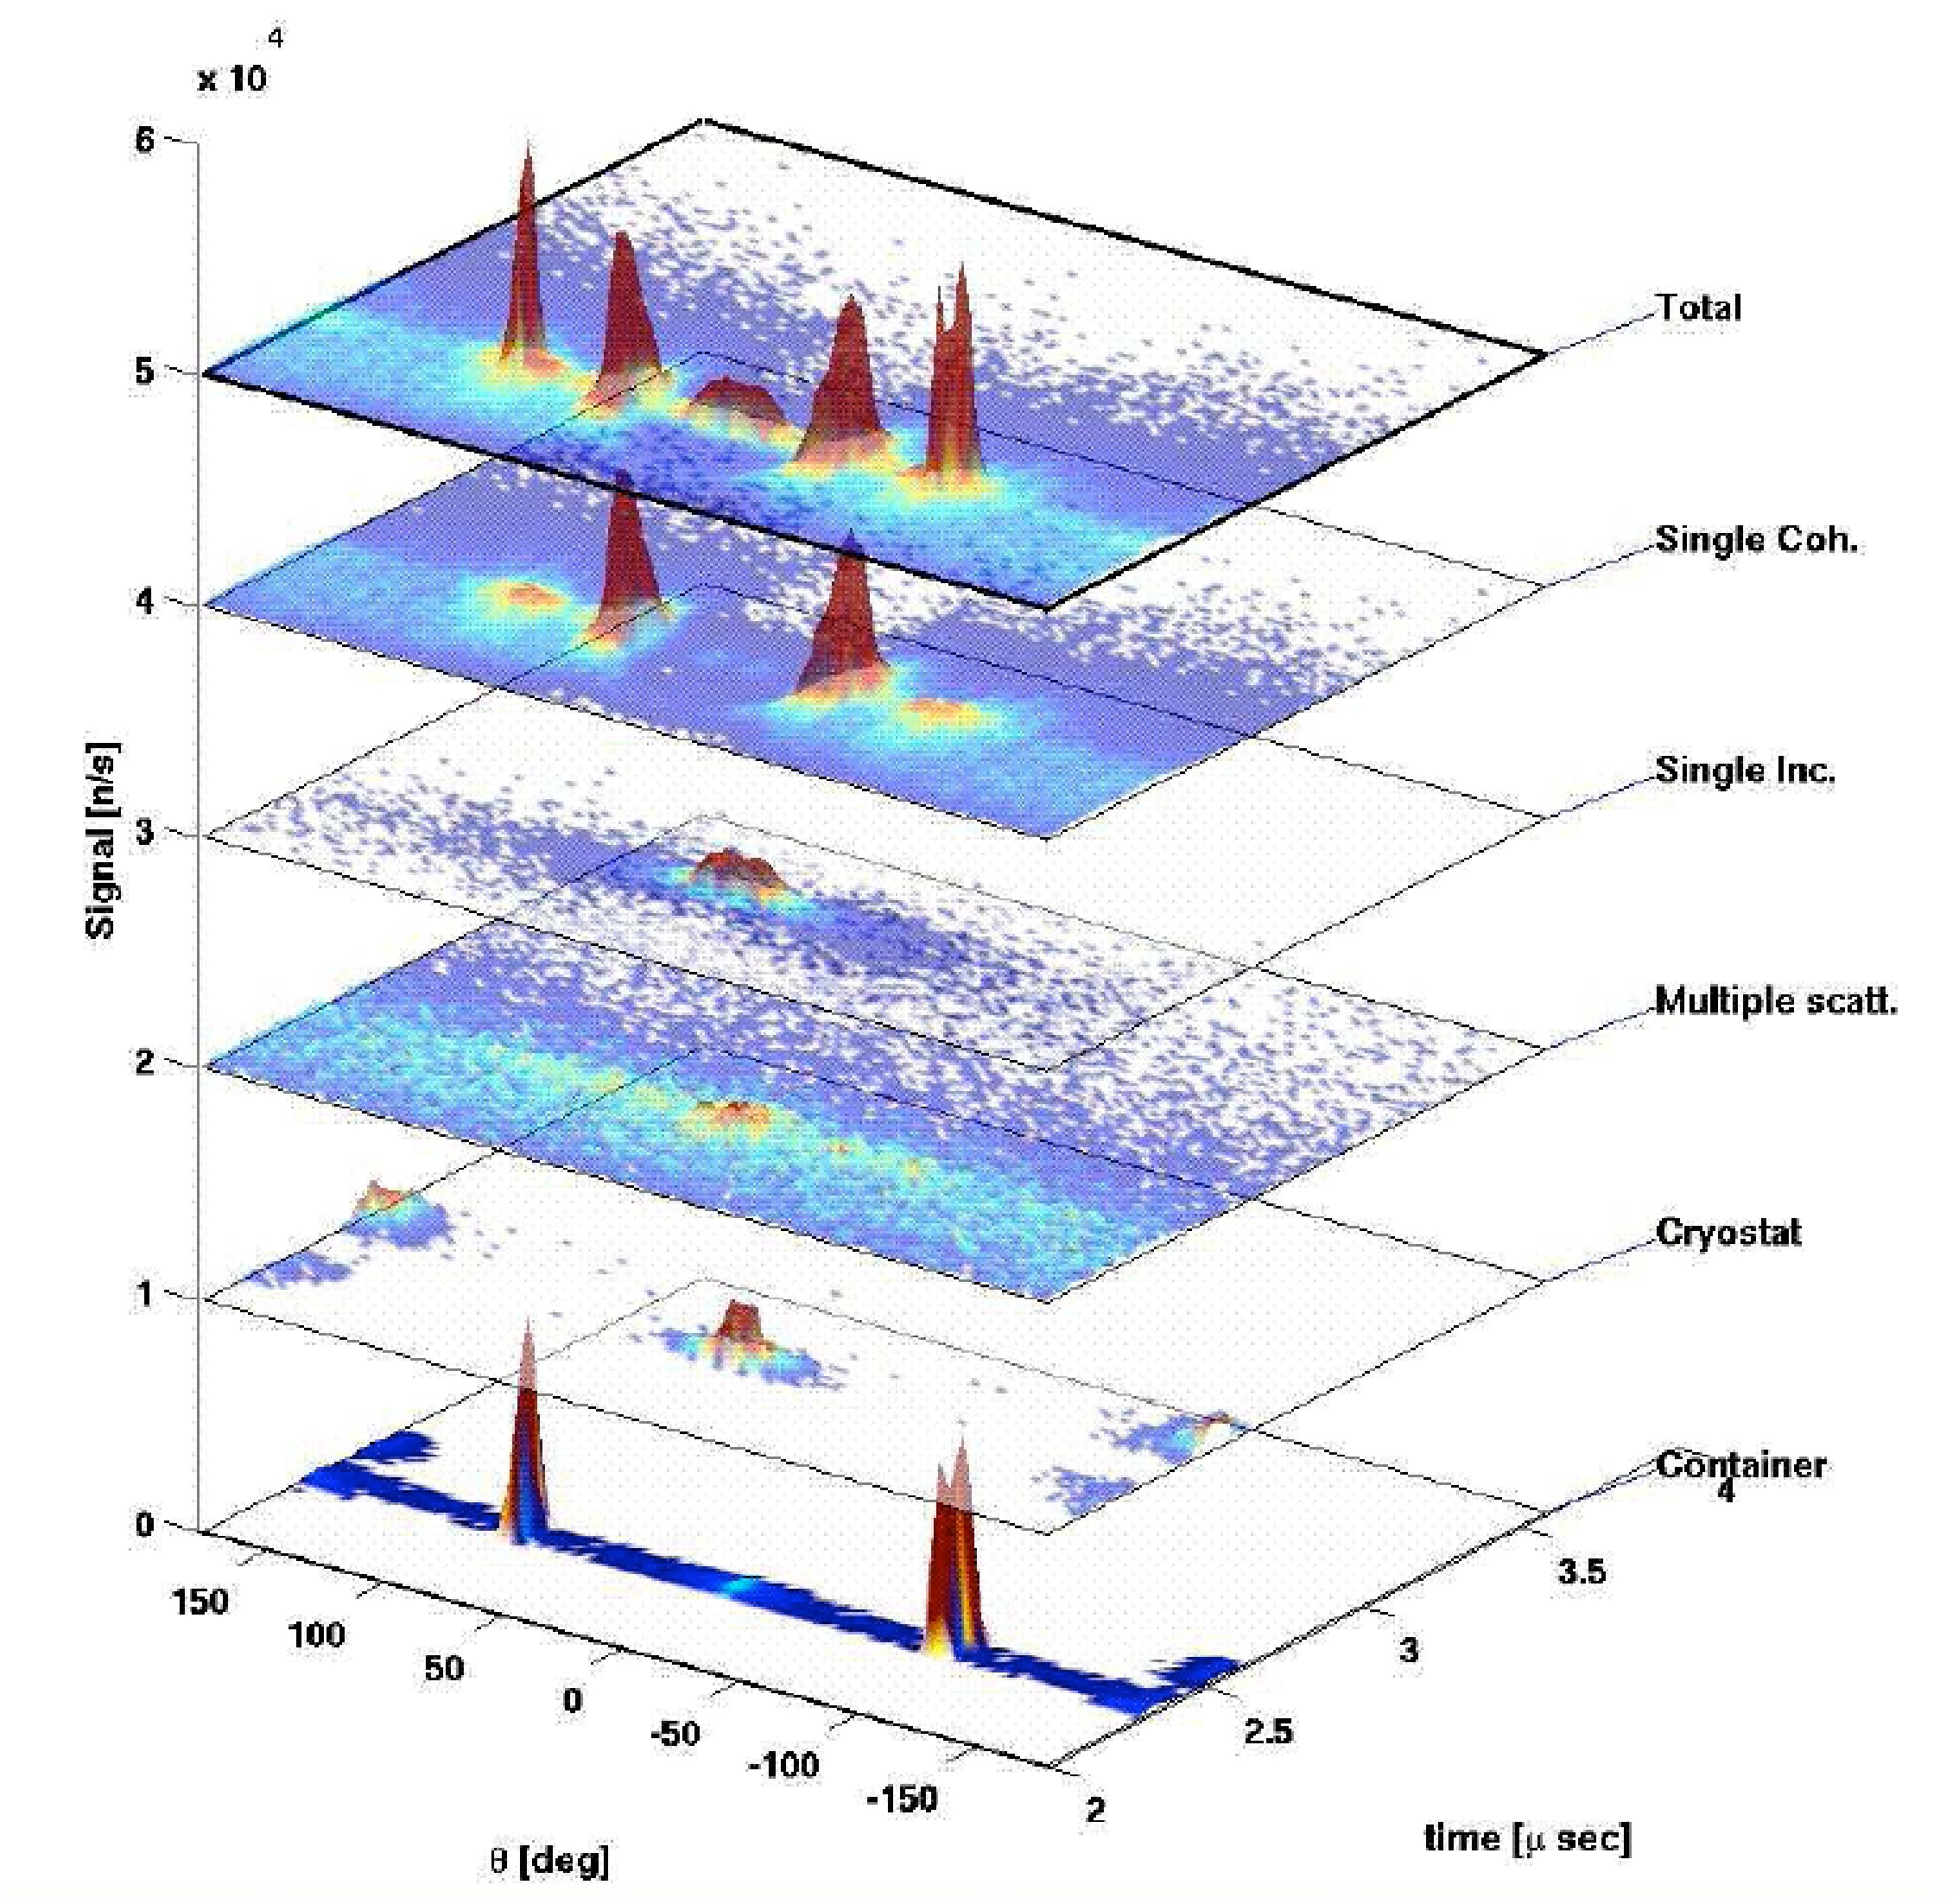
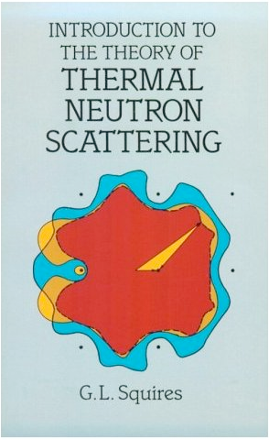
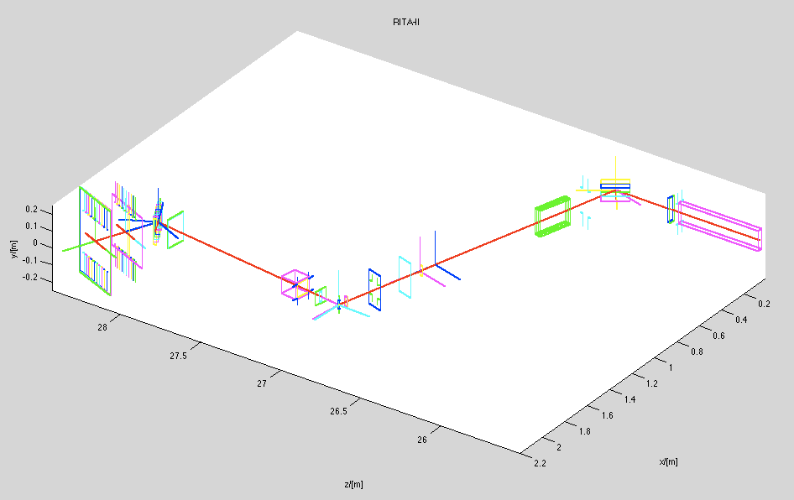
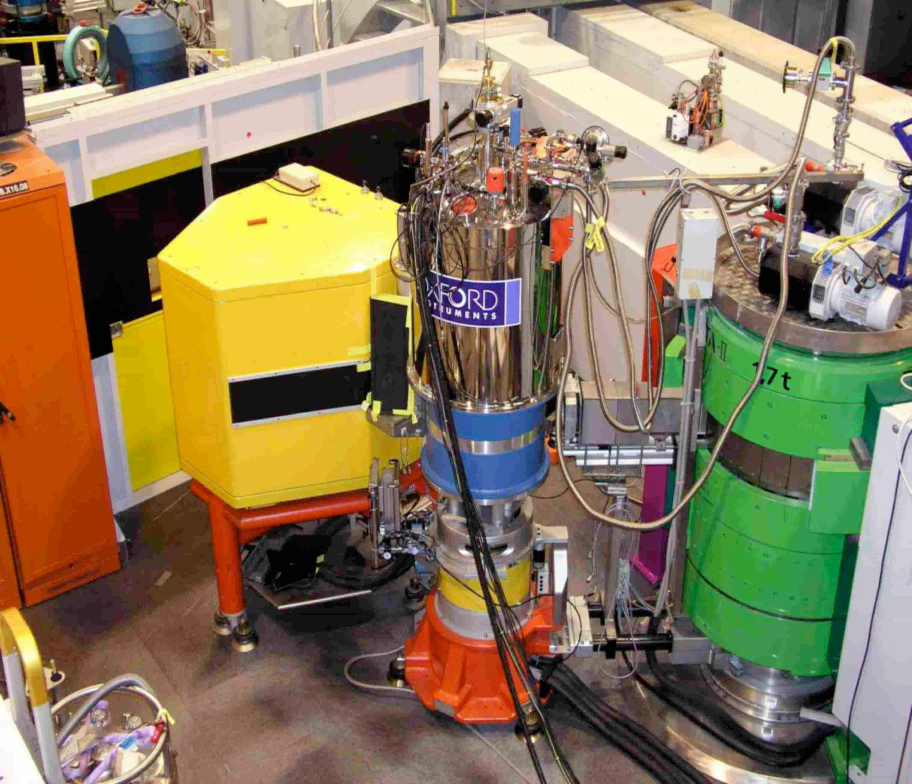
What is McStas used for?
Instrumentation
Virtual experiments
Data analysis
Teaching
(KU, DTU, e-Learning…)
Slides from Peter Willendrup: NOBUGS|2016 / Integrating software: SASview, McStas and Mantid
NOBUGS|2016 / Integrating software: SASview, McStas and Mantid

Slide 28


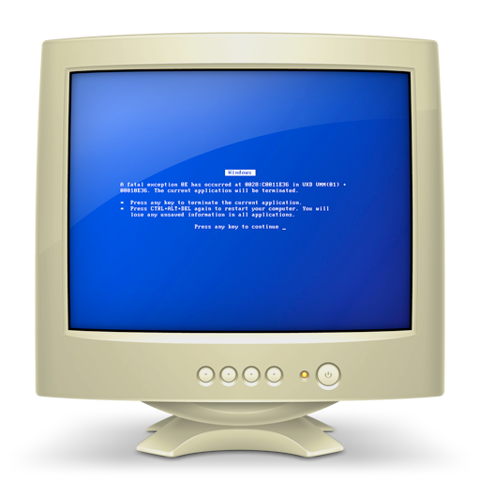
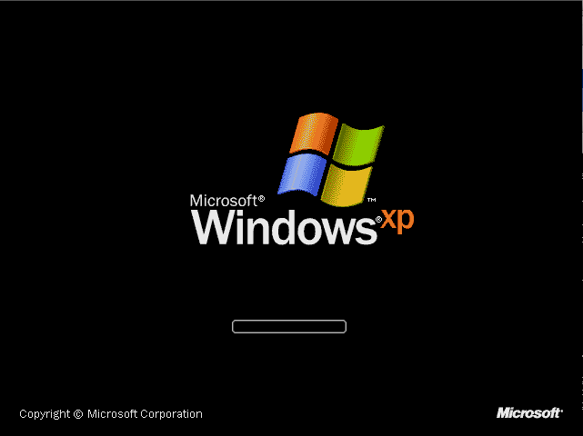
McStas overview
Portable code (Unix/Linux/Mac/Windows)
Ran on everything from iPhone to 1000+ node cluster!
'Component' files (~150) inserted from library
Sources
Optics
Samples
Monitors
If needed, write your own comps (short ~200 LoC)
DSL + ISO-C code gen.
Instrument file (average
user, point/click, DSL)
Component (advanced user, modify from
existing, c-code)
Kernel
(McStas team)
Slides from Peter Willendrup: NOBUGS|2016 / Integrating software: SASview, McStas and Mantid

Slide 29
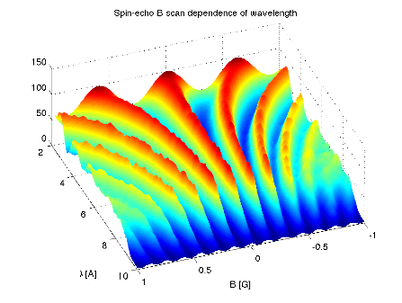
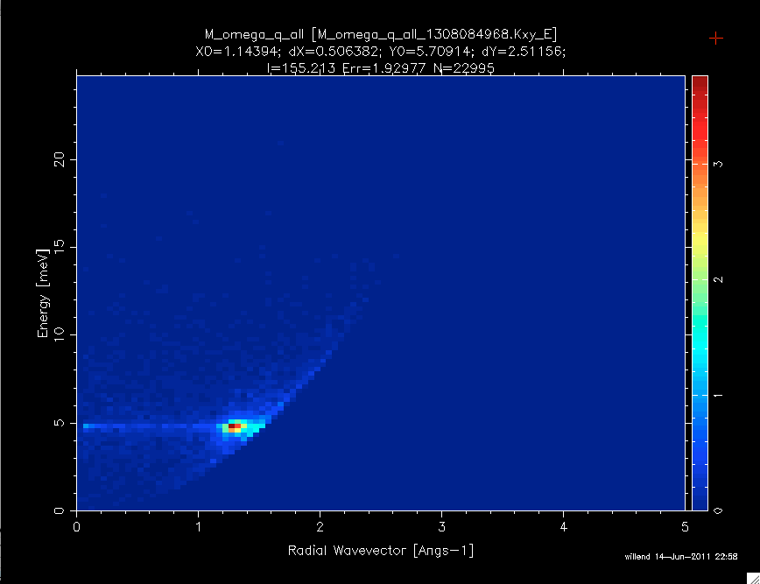
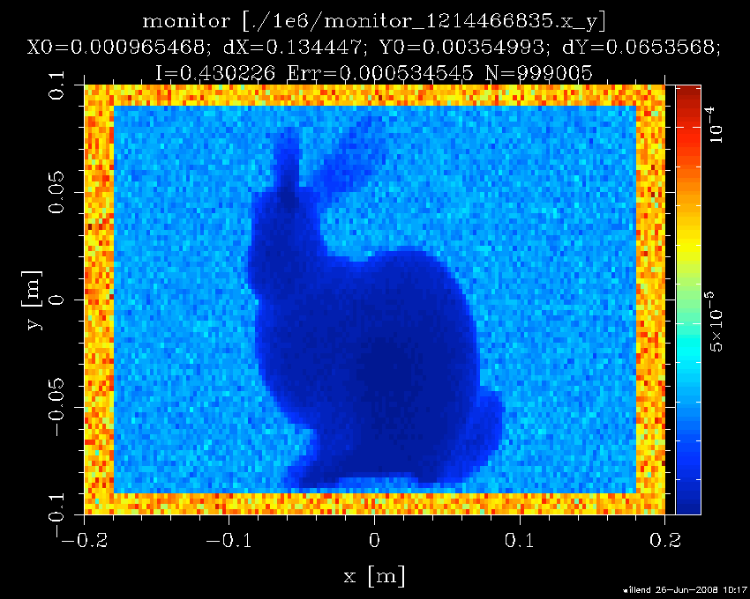
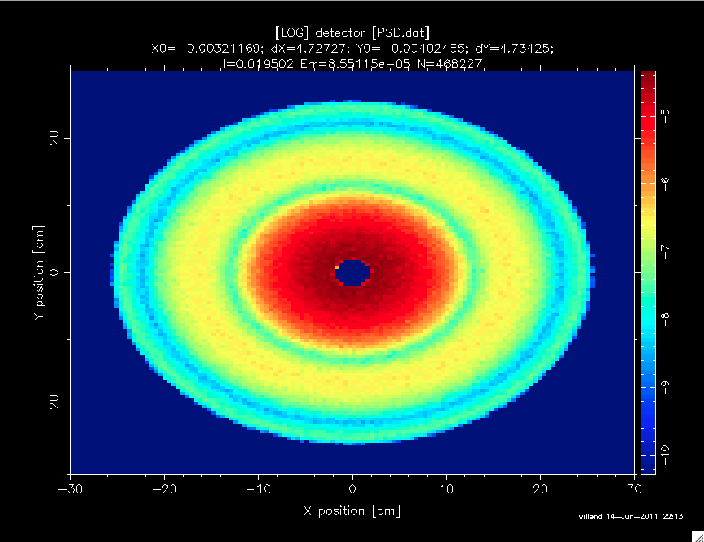
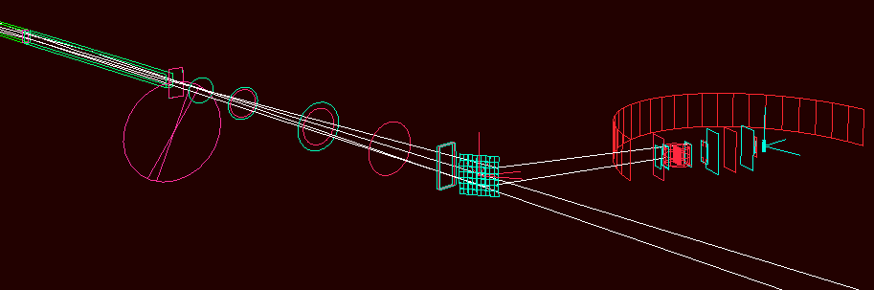
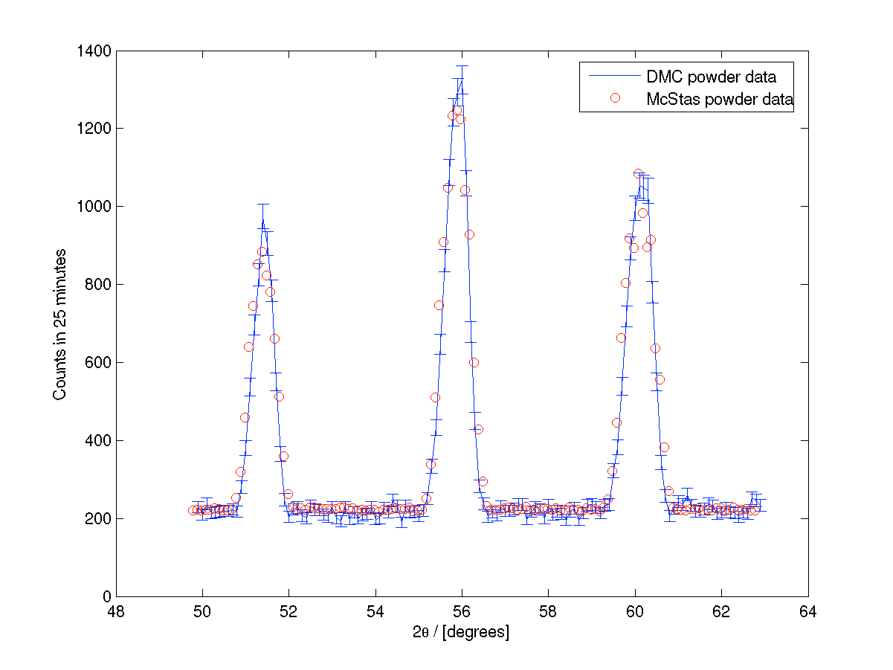
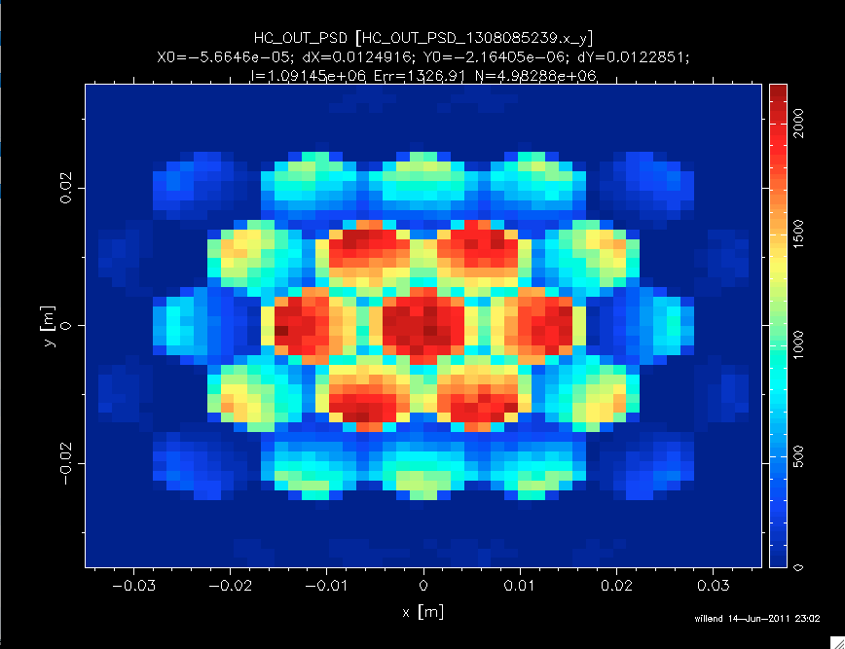
Example suite: 123 instruments
NOBUGS|2016 / Integrating software: SASview, McStas and Mantid

Slide 30
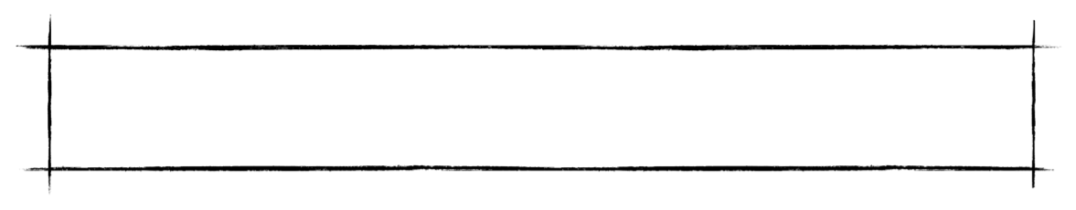
Example suite: 123 instruments
( )
McStas includes “everything” to simulate “anything” at a neutron scattering instrument
( )
NOBUGS|2016 / Integrating software: SASview, McStas and Mantid

Slide 31
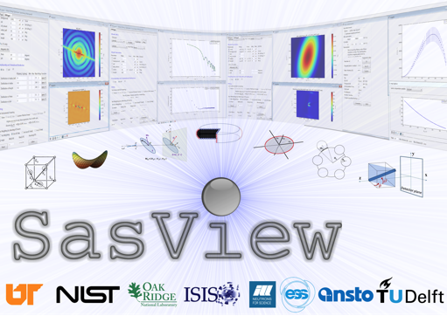
SasView - Small Angle Scattering Analysis
Operates on reduced scattering data
Performs modeling in inverse space
Data analysis toolbox:
Fitting models to data
P(r) inversion
Model-independent analysis
Other useful tools
Slides from Peter Willendrup: NOBUGS|2016 / Integrating software: SASview, McStas and Mantid

Slide 32
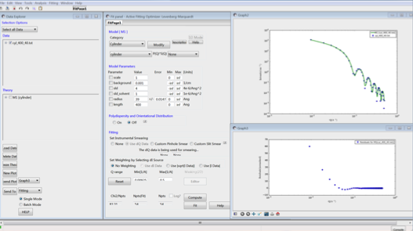
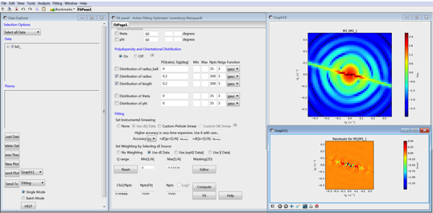
SasView - Fitting
Handles 1D and 2D data
support for canSAS XML & NXcanSAS formats
Form and structure factors for various particle shapes
Different optimizers (Bayesian Statistics)
Allows polydispersity
Simultaneous and batch fitting
Slides from Peter Willendrup: NOBUGS|2016 / Integrating software: SASview, McStas and Mantid

Slide 33
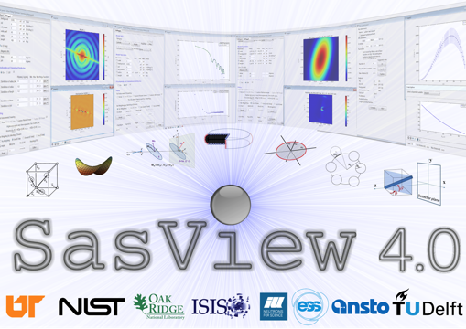
SasView 4.0 is out
SasView "built-in" models have been separated out into an independent package (aka SASmodels)
Easy to add custom user models (including advanced)
Support for OpenCL
All model documentation has been reviewed and updated
Number of minor bugs fixed
Available from:
https://github.com/SasView/sasview/releases/tag/v4.0
Slides from Peter Willendrup: NOBUGS|2016 / Integrating software: SASview, McStas and Mantid

Slide 34

SasView 4.0 is out
SasView "built-in" models have been separated out into an independent package
Easy to add custom user models (including advanced)
Support for OpenCL
All model documentation has been reviewed and updated
Number of minor bugs fixed
What will access to SASview give McStas?
(and lots of them…!)
Slides from Peter Willendrup: NOBUGS|2016 / Integrating software: SASview, McStas and Mantid

Slide 35

What will access to Mantid give McStas?
Source
position
Sample
position
Detector pixel
positions
(Presentation and handling of simulation data
ala non-virtual ToF instruments…)
Slides from Peter Willendrup: NOBUGS|2016 / Integrating software: SASview, McStas and Mantid

Slide 36




Why – instrument development
McStas used for instrument design work at
LoKI team needed 2D scattering kernels in McStas
Use SasView scattering kernels in McStas
SasView scattering kernel: Orientated cylinder
Mantid is reduction software for
Make solution with all 3 for bootstrapping the analysis pipeline!
Slides from Peter Willendrup: NOBUGS|2016 / Integrating software: SASview, McStas and Mantid

Slide 37

McStas mcdoc: SasView_model
Slides from Peter Willendrup: NOBUGS|2016 / Integrating software: SASview, McStas and Mantid

Slide 38


McStas mcdoc: SasView_model
Normal
McStas
interface
…
…
…
…
…
with
access to
SASview
models
and their
docs
…

Slide 39

McStas mcdoc: SasView_model
Links to SasView documentation
Slides from Peter Willendrup: NOBUGS|2016 / Integrating software: SASview, McStas and Mantid

Slide 40

SasView -> McStas -> SasView
SasView cylinder model (1D) scattering kernel used in McStas
radius = 40 Å, length = 400 Å
McStas event data saved as I(q)
SasView reads McStas I(q) data
SasView fit engine gives:
radius = 40 Å
Length = 401 Å
Slides from Peter Willendrup: NOBUGS|2016 / Integrating software: SASview, McStas and Mantid

Slide 41



SasView -> McStas -> Mantid -> SasView
McStas -> event data
Mantid -> I(qx,qy)
SasView -> model parameters
2D scattering kernel: Orientated cylinder
Slides from Peter Willendrup: NOBUGS|2016 / Integrating software: SASview, McStas and Mantid

Slide 42



McStas data in Mantid
mcdisplay 3d-visualiser modified to generate Mantid IDF xml file
Monitor_nD (E. Farhi) output event data with “Pixel ID” and ToF
Rectangular geometry
Cylindrical geometry
“Freeform” OFF surface geometry
templateSANS_Mantid.instr
McStas > 2.1 on machine, NeXus libs, Mantid
Special component naming, defines source, sample and detectors for Mantid geometry
Generate XML using mcdisplay --format=Mantid
Run with mcrun/mcgui selecting NeXus output
Nielsen, T.R.; Markvardsen, A.J.; Willendrup, P.: McStas and Mantid integration
Journal of Neutron Research, vol. 18, no. 2-3, pp. 61-77, 2015
DOI: 10.3233/JNR-16002
Notes:
Figure 2: McStas simulate mode. Recorded SANS pattern histogram from a 2D position sensitive detector (PSD). The instrument model is templateSANS_Mantid and the sample is hard spheres in dilute solution.

Slide 43
McStas data in Mantid
templateSANS_Mantid.instr
Notes:
Figure 2: McStas simulate mode. Recorded SANS pattern histogram from a 2D position sensitive detector (PSD). The instrument model is templateSANS_Mantid and the sample is hard spheres in dilute solution.

Slide 44


Data reduction and analysis
Mantid view of the McStas event data generated for the ISIS_SANS2d.instr file.
Comparison of rescaled scatting intensity I(q) derived from the experimental data and a McStas simulation.

Slide 45



LoKI detector
in OFF file
2D scattering kernel from
Events visualised in Mantid instrument 3D view
McStas
simulation
Use: Check out
templateSANS_Mantid
from the McStas distribution
- fully functional reduction
Events processed using Mantid algorithms
NOBUGS|2016 / Integrating software: SASview, McStas and Mantid

Slide 46

Optimization Of Molecular Dynamics Simulations

Slide 47




Sassena support in Mantid
Like nMoldyn, Sassena calculates neutron and X-ray scattering functions from molecular dynamics atomic trajectories.
→ www.sassena.org
Mantid algorithms load Sassena output and carry out its Fourier transform
$$I\left(Q,t\right)$$
S$\left(Q,E\right)$
Algorithms released as part of Mantid: www.mantidproject.org

Slide 48

DSFinterp1DFit
A Mantid fitting function to optimize simulated QENS spectra against experiment.
fit function released as part of Mantid: www.mantidproject.org
requires external python library dsfinterp (https://pypi.python.org/pypi/dsfinterp/0.1)
Notes:
This fitting function loads a number of simulated S(Q,E,X) where X represents a force-field parameter of the simulation, and is treated here as a fitting parameter. The fit function will try to find the value of X that optimizes the simulated structure factor against experimental data.
For instance, user may have calculated S(Q,E) at 10 different values of a force-field parameter (that is, 10 different simulations and 10 different structure factors S(Q,E,X_1), S(Q,E,X_10) ). The fit function will load these structure factors and use interpolation to generate any S(Q,E,X) with X in between X_1 and X_10. This way we can continuously vary X until the fitting process find the optimal X.

Slide 49



Application of DSFinterp1DFit
Example: optimization of the energy barrier to methyl rotations in the octamethyl silsesquioxane molecule.
Data taken at BASIS
Data reduced with Mantid
Analysis using NAMD, AmberTools, Sassena, and Mantid
Borreguero, Jose M., and Vickie E. Lynch. "Molecular dynamics force-field refinement against quasi-elastic neutron scattering data." Journal of Chemical Theory and Computation 12,9 (2016).
Notes:
In this example, QENS data was taken at BASIS for this cage molecule. S(Q,E) probes the dynamics of the rotation of the methyl groups. In the animated GIF I highlighted in gold one of the hydrogen atoms of a particular methyl group. We can use this QENS data to tune the potential energy governing these rotations in a simulation, that is, find the potential energy barrier K that will result in a simulated S(Q,E) that is comparable to the experimental QENS data. Fit function DSFinterp1DFit will load a number of simulated S(Q,E) for different values of the energy barrier, smooth and use interpolation to fit against experimental data, and in this way obtain the optimal energy barrier K=1.15Kcal/mol) On the right is the dependence of the goodness of fit Chi-square between simulation and experiment against the energy barrier, for two values of momentum transfer Q. (Note: in the Chi-square plot, the values of K on the X-axis must be multiplied by 18 in order to yield the total energy barrier because every methyl group is subjected to 9 different torsional potentials of the same kind, and the functional form of the potential requires a further factor of two)

Slide 50




Development – Force Field Refinement
+ +
The Bellerophon Environment integrates Mantid and Sassena, utilizing OLCF, NERSC, and CADES compute resources to automate workflows for parameter-refinement of force-fields used in molecular dynamics simulations, by iterative optimization against QENS data
E. Lingerfelt et al., “Near Real-time Scalable Analysis of High-dimensional Nanophase Materials Imaging and Neutron Science Data in the DOE HPC Cloud with BEAM”, 2015 International Conference for High Performance Computing, Networking, Storage and Analysis, Nov. 18, Austin, TX
Notes:
This utility developed at ORNL allows the user to carry out molecular dynamics simulations in a remote cluster, then use Sassena to calculate the simulated QENS spectra, and then use Mantid to fit the simulated spectra (black lines) against the experimental data (colored lines). The user can change one parameter in the force-field of the simulations in order to obtain a different simulated QENS spectra. In this fashion the user can tune the force field to optimize against QENS data. In the movie, user is changing the barrier to methyl rotations shown in the previous slide and then comparing against QENS data. The movie begins with a value of the force field yielding a goodness of fit Chi-square too high, and little by little user chooses values of the force field yielding lower values of Chi-square.
The GUI is installed in the user’s laptop, while computation, analysis, and data storage is carried out elsewhere.

Slide 51
Conclusions
Mantid is looking to work with, not replace accepted and loved analysis tools
Mantid is a capable tool for comparing experimental data to simulations
Mantid is capable of simple to complex model optimization
With a bit more hardware you can optimize the simulations to the experimental data

Slide 52









Contributors
Partners
Prime Contractor
Contributors

